Slide 1


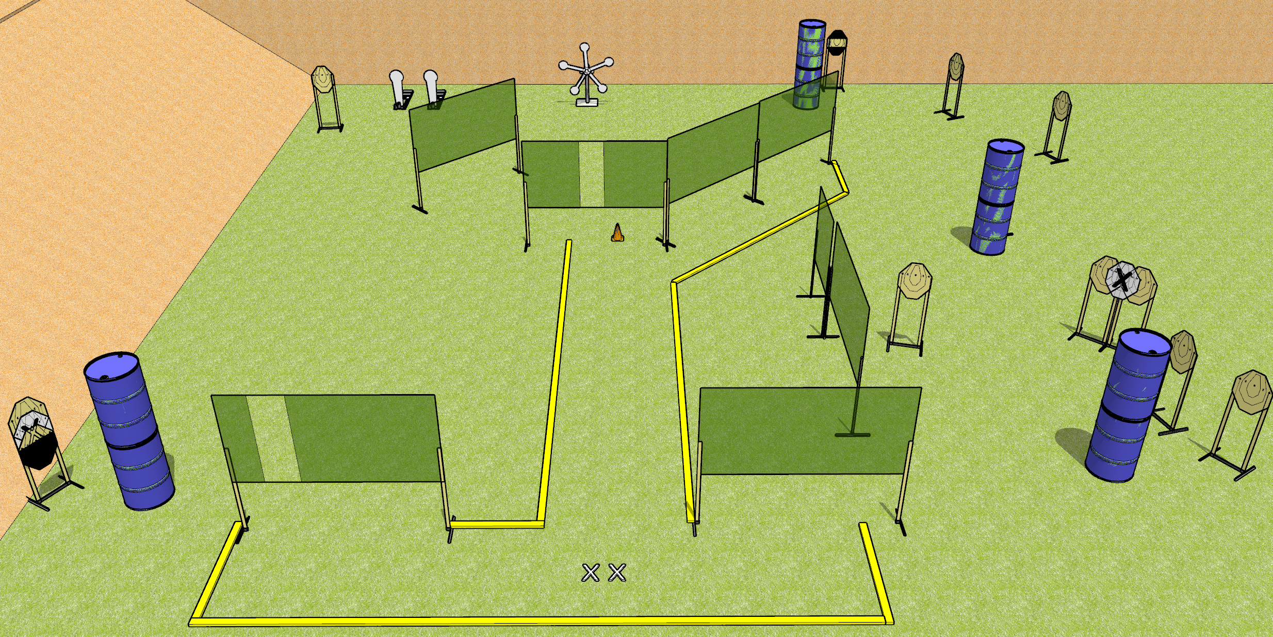
 | Dothan Gun Club – USPSA Match Turtles Everywhere Course Designer : Drew Coleman
START POSITION : Standing with both feet on X’s. Hands relaxed at sides.
GUN READY CONDITION : Pistol loaded and holstered. PCC shouldered, safety on, pointed at orange cone. |  | SCORING: Comstock, 31 rounds TARGETS: 12 paper, 7 Steel SCORED HITS: Best 2 on paper, steel until down START-STOP: Audible, last shot RULES:
STAGE PROCEDURE: Engage targets as they become available from within the fault lines

